Slide 1

Reversible Location Cloaking for Protecting Multi-level Location Privacy
Chao Li, Balaji Palanisamy
School of Information Sciences
University of Pittsburgh

Slide 2
Outline
Introduction
Motivation and Objective
Technical details
Experiments
Conclusion

Slide 3
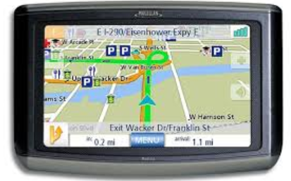
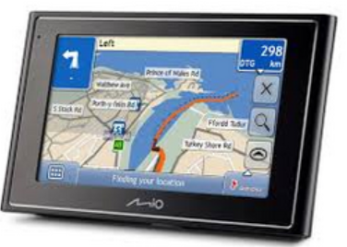
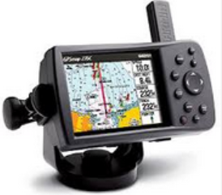
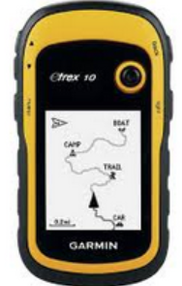
The increasing GPS market
The GPS market generated $9.1 billion in 2011 and is expected to generate $26.36 billion by 2016 at a CAGR of 23.7% from 2011 to 2016.

Slide 4
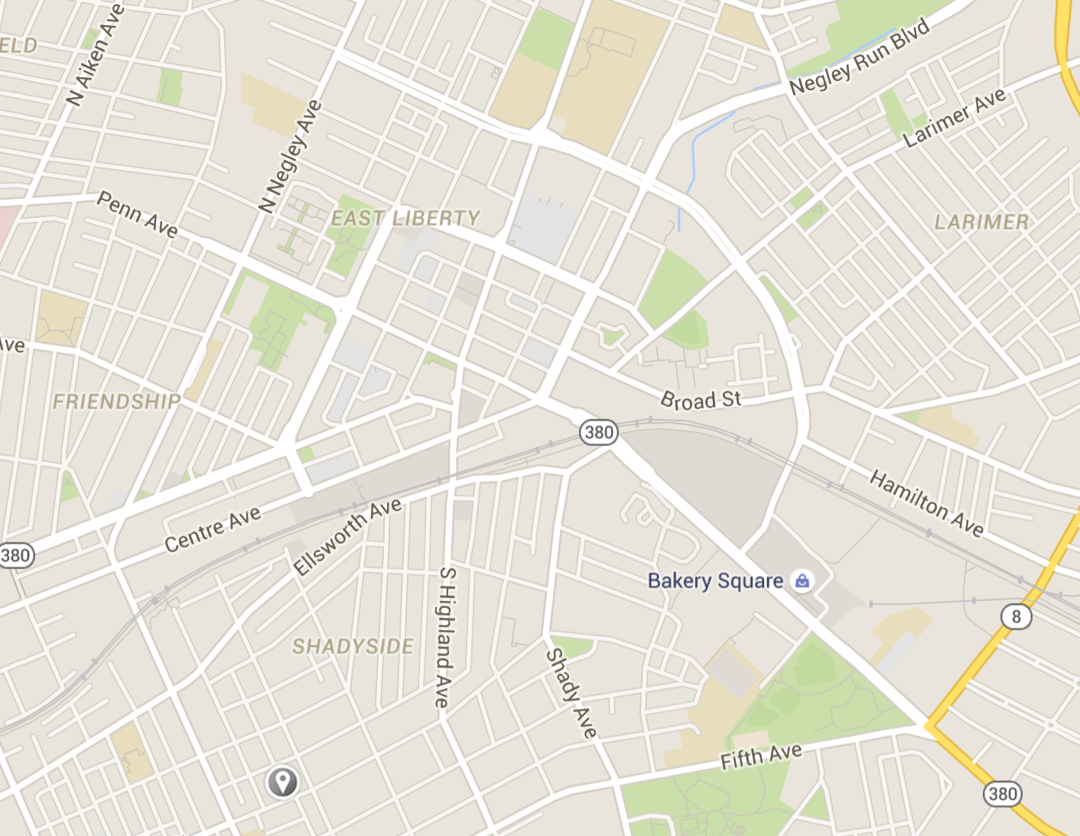
Location-based services
There are many types of location based services.
Spatial alerts
Location-based social networking
Searching nearest points of interest
“Tell my friends where I am.”
“Remind me when I drive
close to the grocery store.”
“where is the nearest gas station to my
current location?”

Slide 5
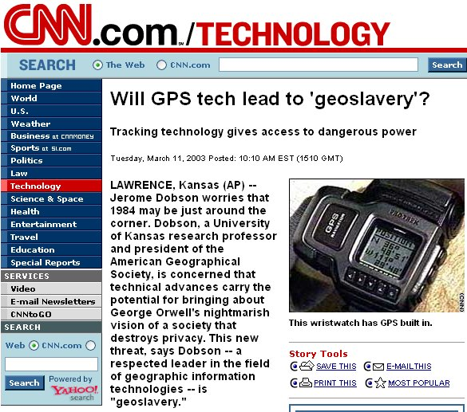
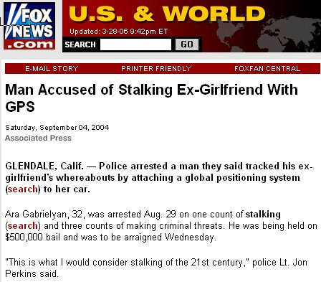

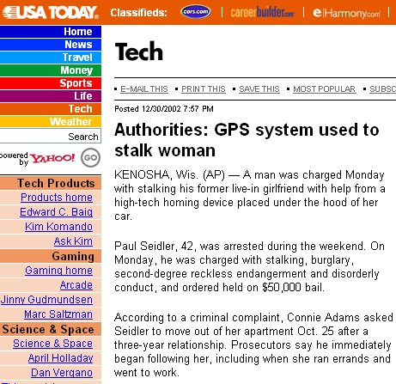
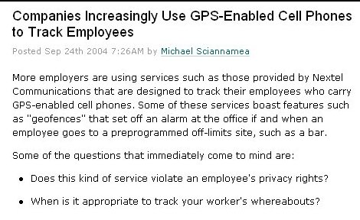
Privacy threats
While location-based services find numerous potential benefits, they also open new doors for privacy threats.

Slide 6
Location privacy
One major technique to protect location privacy:
Location anonymization: the process of perturbing user location information such that it masks the exact location of the user using a cloaked region.
K-anonymization:
Gruteser, Grunwald [2003], Gedik, Liu [2005], Mokbel, Chow, Aref [2006], G. Ghinita [WWW, 2007],P. Kalnis [TKDE, 2007], Masoumzadeh, Karimi, Joshi [2009], B. Ying [CCW, 2014], H.J. Cho [DPD, 2014]N.E. Bordenabe [CCS, 2014]
L-diversity:
Privacygrid - Bhuvan, Liu [2008], Xstar - Ting, Liu [2010]

Slide 7

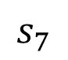
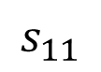
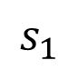
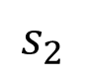
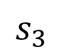
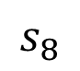
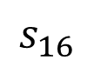
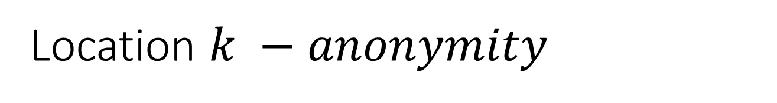
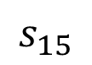
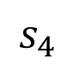
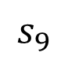
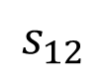
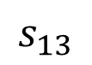
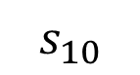
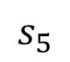
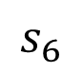
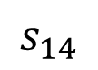
Location $k −anonymity$
Location k-anonymity, ensures that the exposed location of a user is indistinguishable from a set of other users on the road network.
$$s_{3}$$
$$s_{7}$$
$$s_{2}$$
$$s_{15}$$
$$s_{4}$$
$$s_{13}$$
$$s_{6}$$
k = 4
$$s_{1}$$
$$s_{8}$$
$$s_{14}$$
$$s_{9}$$
$$s_{16}$$
$$s_{11}$$
Cloaking region:
{s8, s9, s11, s14}
$$s_{10}$$
$$s_{5}$$
$$s_{12}$$

Slide 8



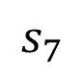
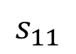
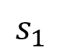
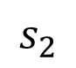
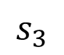
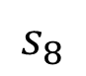
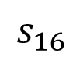
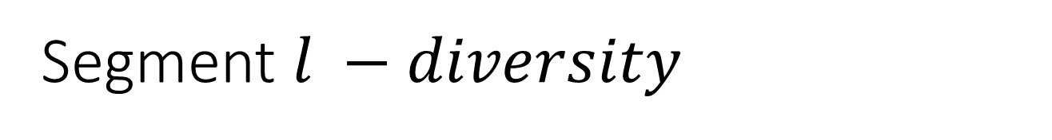
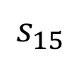
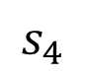
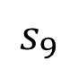
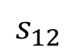
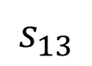
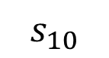
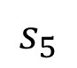
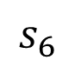
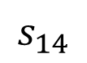
Segment $l −diversity$
Conventional anonymization techniques
are unidirectional solutions,
which means perturbed data cannot be restored.
However, satisfying location k-anonymity alone may not be sufficient to protect the location privacy of the user in cases when there are homogeneity attacks.
$$s_{3}$$
$$s_{7}$$
k = 3
$$s_{2}$$
$$s_{15}$$
Conventional anonymization techniques
are single-level solutions,
which means the anonymization level of
perturbed data cannot be changed.
$$s_{4}$$
Cloaking region:
{s4, s6, s8}
$$s_{13}$$
k = 3
l = 3
$$s_{6}$$
$$s_{1}$$
$$s_{8}$$
$$s_{14}$$
$$s_{9}$$
$$s_{16}$$
$$s_{11}$$
$$s_{10}$$
These findings motivate our works.
$$s_{5}$$
$$s_{12}$$

Slide 9
Outline
Introduction
Motivation and Objective
Technical details
Experiments
Conclusion

Slide 10





Objective: Multilevel reversible location anonymization
Cloaked location information
Release to all the parties
Raw location information
Reversible cloaking
convertional cloaking
What if they have different requirements and privileges and some of them want or have to get less-perturbed information?
No privilege parties:
All the parties can see the whole cloaked region, but parties without enough privilege cannot get access to next level.
Highest privilege parties:
They have the highest privilege, so give them the raw data.
Conventional single-level unidirectional techniques
only focus on the anonymization, but fail to further
control the access to cloaked data in a
multi-level fine-grained manner.
High privilege parties:
They are more reliable, so they are allowed to get more information.
Low privilege parties:
They can get more accurate information, but cannot be closer to the real location.

Slide 11
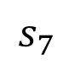
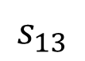
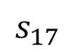
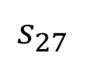
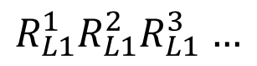
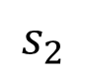
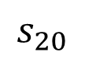
































Multilevel reversible location anonymization
$$s_{4}$$
$$s_{13}$$
$$s_{21}$$
$$s_{28}$$
$$s_{8}$$
$$s_{17}$$
$$s_{23}$$
$$s_{31}$$
Anonymization
$$s_{1}$$
$$s_{14}$$
$$s_{29}$$
$$R_{L3}^{1}R_{L3}^{2}R_{L3}^{3}…$$
$$s_{9}$$
$$s_{18}$$
$$s_{5}$$
$$s_{24}$$
$$\left(δ_{k}^{3}, δ_{l}^{3}\right)$$
$$s_{22}$$
$$s_{32}$$
$$s_{10}$$
$$s_{19}$$
$R_{L2}^{1}R_{L2}^{2}R_{L2}^{3}$ $…$
$$s_{15}$$
$$s_{25}$$
$$s_{2}$$
$$s_{30}$$
$$s_{11}$$
$\left(δ_{k}^{2}, δ_{l}^{2}\right)$
$$s_{6}$$
$$s_{20}$$
$$s_{26}$$
$$s_{33}$$
$R_{L1}^{1}R_{L1}^{2}R_{L1}^{3}$ $…$
$$s_{3}$$
$$s_{12}$$
$$s_{7}$$
$$s_{16}$$
$$s_{27}$$
$$\left(δ_{k}^{1}, δ_{l}^{1}\right)$$
De-anonymization

Slide 12
















1st class of conventional techniques – Random Sampling
$$s_{3}$$
$$s_{7}$$
$$s_{2}$$
$$s_{15}$$
$$s_{4}$$
$$s_{13}$$
$$s_{6}$$
$$s_{1}$$
$$s_{8}$$
$$s_{14}$$
$$s_{9}$$
$$s_{16}$$
$$s_{11}$$
$$s_{10}$$
$$s_{5}$$
$$s_{12}$$
Pros: High randomness.
Cons: High cost, inaccurate feedback.

Slide 13
















2nd class of conventional techniques – Network Expansion
$$s_{3}$$
$$s_{7}$$
$$s_{2}$$
$$s_{15}$$
$$s_{4}$$
$$s_{13}$$
$$s_{6}$$
$$s_{1}$$
$$s_{8}$$
$$s_{14}$$
$$s_{9}$$
$$s_{16}$$
$$s_{11}$$
$$s_{10}$$
$$s_{5}$$
$$s_{12}$$
Pros: The tight structure can do scalable and efficient query processing.
Cons: Unidirectional, single-level.

Slide 14
Outline
Introduction
Motivation and Objective
Technical details
Experiments
Conclusion

Slide 15














Reversible location cloaking
For each transition (add/remove), we assign transition values to all possible transitions, then calculate pick value to choose one.
$$s_{13}$$
$$s_{21}$$
Forward transitions:
0
4
$$s_{23}$$
$$s_{8}$$
$$s_{17}$$
$R_{1}R_{2}…R_{i}$…$R_{n−1}$
$$s_{14}$$
$$s_{9}$$
$$s_{18}$$
Scheme 1：
No. of possible transitions: 5 (global: pick the adjacent segments of the whole cloaking region)
Transition values: 0, 1, 2, 3, 4
Assign the transition values.
Calculate pick value = R2 mod 5= 4 (assumed)
Do the forward transition and add the new segment to cloaking region.
1
3
$$s_{24}$$
2
$$s_{22}$$
$$s_{10}$$
$$s_{19}$$
$$s_{15}$$
Current cloaking region
Candidate expansion region

Slide 16





Reversible location cloaking
$$s_{13}$$
$$s_{21}$$
0
4
Backward transition:
$$s_{8}$$
$$s_{17}$$
$$s_{23}$$
2
$$s_{14}$$
$R_{1}R_{2}…R_{i}$…$R_{n−1}$
1
$$s_{18}$$
$$s_{9}$$
1
3
0
3
$$s_{24}$$
Scheme 1：
Remove the last segment to restore the situation of corresponding forward transition.
For each segment within cloaking region:
Assume it is the last but one selected segment.
Redo forward transition.
Check whether the last segment (the 3rd chosen segment in this case) can be chosen.
2
$$s_{22}$$
$$s_{10}$$
4
$$s_{19}$$
$$s_{15}$$
Collision:
More than one segment within cloaking region choose the correct last segment.
We propose Reversible Global Expansion to carefully assign transition values to avoid collisions in scheme 1.

Slide 17

Reversible location cloaking
$$s_{13}$$
$$s_{21}$$
Forward transitions:
0
2
4
$$s_{8}$$
$$s_{17}$$
$$s_{23}$$
$R_{1}R_{2}…R_{i}$…$R_{n−1}$
$$s_{14}$$
$$s_{9}$$
$$s_{18}$$
Scheme 2：
No. of possible transitions: 5 (local: pick the adjacent segments of the last selected segment, maybe multi-hop to satisefy the pre-defined 5, which should be fixed for both forward and backward transitions)
Transition values: 0, 1, 2, 3, 4
Assign the transition values.
Calculate pick value = R2 mod 5= 4 (assumed)
Do the forward transition and add the new segment to cloaking region.
1
3
$$s_{24}$$
$$s_{22}$$
$$s_{10}$$
$$s_{19}$$
$$s_{15}$$
Current cloaking region
Candidate expansion region

Slide 18






Reversible location cloaking
$$s_{13}$$
$$s_{21}$$
Backward transition:
$R_{1}R_{2}…R_{i}$…$R_{n−1}$
3
0
$$s_{8}$$
4
$$s_{17}$$
$$s_{23}$$
Scheme 2：
Do not remove the last segment to restore the corresponding forward transition.
From the last segment (s17):
No. of possible backward transitions: 5. (same as forward, use multi-hop transitions if required)
Backward transition values: 0, 1, 2, 3, 4
Assign the backward transition values.
Calculate pick value = R2 mod 5 = 4 (same as forward)
Do the backward transition, the transition with value 4 shall be picked. To pick the right segment (s14), 4 should be assigned to this backward transition.
$$s_{14}$$
1
2
$$s_{9}$$
$$s_{18}$$
$$s_{24}$$
$$s_{22}$$
$$s_{10}$$
$$s_{19}$$
$$s_{15}$$
Backward candidate region
Collision:
If any of forward transitions from other segments ($s_{13}$, $s_{18}$, $s_{21}$, $s_{23}$)within backward candidate region to $s_{17}$ has forward transition value 4, 4 has to be assigned to multiple backward transitions.
We propose Reversible Pre-assignment-based Local Expansion to carefully pre-assign transition values to avoid collisions in scheme 2.

Slide 19



















Reversible global expansion
To solve collision in scheme 1.
Order: length of segments
$$s_{3}$$
$$s_{7}$$
$$s_{2}$$
$$s_{15}$$
 | $$s_{10}$$ | $$s_{14}$$ | $$s_{6}$$
$$s_{9}$$
$$s_{8}$$
$$s_{11}$$
$$s_{4}$$
$$s_{6}$$
$$s_{13}$$
Previous segment
2
transition value for each cell =
(cId+rId) mod |C|
cId: column ID
rId: row ID
|C|: No. of columns
0
1
Next segment
$$s_{1}$$
$$s_{8}$$
$$s_{14}$$
$$s_{11}$$
1
2
0
Cloaking region
$$s_{9}$$
$$s_{16}$$
$$s_{10}$$
2
0
1
Candidate region
$$s_{5}$$
$$s_{12}$$
$R_{1}R_{2}…R_{i}$…$R_{n−1}$
$pick value= R_{i} mod 3$= 2
Since transition values do not repeat in each row (forward) and column (backward), no collision will happen.

Slide 20




































Reversible pre-assignment-based local expansion
To solve collision in scheme 2.
$$s_{3}$$
$$s_{7}$$
$$s_{6}$$
$$s_{10}$$
$$s_{14}$$
$$s_{12}$$
$$s_{13}$$
$$s_{6}$$
 | $$…$$ | $$…$$ | $$…$$ | $$…$$ | $$…$$ | $$…$$
$$s_{2}$$
$$s_{15}$$
$$Forward$$
$$s_{4}$$
$$Backward$$
$$s_{6}$$
$$s_{13}$$
$$s_{1}$$
$$s_{8}$$
$$s_{14}$$
$$s_{11}$$
$$s_{9}$$
$$s_{16}$$
 | $$…$$ | $$…$$ | $$…$$ | $$…$$ | $$…$$ | $$…$$
$$Forward$$
$$Backward$$
$$s_{9}$$
$$s_{11}$$
$$s_{8}$$
$$s_{13}$$
$$s_{15}$$
$$s_{16}$$
$$s_{10}$$
$$s_{5}$$
$$s_{12}$$
$$R_{i} mod 6$$
$$R_{1}R_{2}…R_{i}…R_{n−1}$$

Slide 21





























Reversible pre-assignment-based local expansion
Seg | Adjacent Segs
 | hop -1 | hop -2 | …
Seg | Forward Seg
 | 0 | 1 | … | N-1
$$s_{1}$$
$$s_{2}$$
$$s_{3}$$
$$s_{4}$$
$$s_{5}$$
$$s_{6}$$
$$s_{1}$$
$s_{2}$, $s_{5}$
$\overline{s_{2}s_{3}},$ $\overline{s_{2}s_{4}}$, $\overline{s_{5}s_{10}}$, $\overline{s_{5}s_{12}}$
…
$$s_{2}$$
$$s_{5}$$
$$\overline{s_{2}s_{3}}$$
$$\overline{s_{2}s_{4}}$$
$$s_{2}$$
$$s_{1},s_{3},s_{4}$$
$\overline{s_{1}s_{5}},$ $\overline{s_{3}s_{7}}$, $\overline{s_{4}s_{6}}$
…
$$s_{1}$$
$$s_{3}$$
$$s_{4}$$
$$\overline{s_{1}s_{5}}$$
$$s_{3}$$
$s_{2}$, $s_{4}$, $s_{7}$
…
…
$$s_{4}$$
$s_{2}$, $s_{3}$, $s_{6}$
…
…
…
…
…
…
Based on the adjacent-seg table, build the forward and backward seg table simultaneously.
For each seg si in adjacent-seg table, check its adjacent segs from left to right one by one.
For each checked adjacent segment sj or several segments (multi-hop) smsnsj.
A = list of empty cells in row ‘si’ of forward table.
B = list of empty cells in row ‘sj’ of backward table.
AB = A B = available cells in both row ‘si’ of forward table and row ‘sj’ of backward table. Pick the left most cell, assign sj and si to that cell in row ‘si’ of forward table and row ‘sj’ of backward table respectively.
Repeat until the forward and backward tables are filled.
Seg | Backward Seg
 | 0 | 1 | … | N-1
$$s_{1}$$
$$s_{2}$$
$$s_{3}$$
$$s_{4}$$
$$s_{5}$$
$$s_{6}$$
$$s_{2}$$
$$s_{1}$$
$$s_{2}$$
$$\overline{s_{2}s_{1}}$$
$$∩$$
$$s_{2}$$
$$\overline{s_{2}s_{1}}$$
$$s_{1}$$
$$\overline{s_{1}s_{2}}$$

Slide 22
Outline
Introduction
Motivation and Objective
Technical details
Experiments
Conclusion

Slide 23

Experiment setup
Simulator | GTMobiSim mobile trace generator
Map location | Northwest part of Atlanta
No. of junctions | 6,979
No. of segments | 9,187
No. of cars | 10,000
Distribution model of cars | Gaussian distribution
Algorithms evaluated | Random Sampling (RS) Star-based road-network expansion (SE) ReversibleGlobal Expansion (RGE) Reversible Pre-assignment-based Local Expansion (RPLE)

Slide 24
Performance with Varying Anonymity Level
RPLE is fastest in the anonymization phase.
RPLE is fastest in the de-anonymization phase.

Slide 25
Performance with Varying Anonymity Level
Relative spatial resolution (RSR) is the ratio of size of the maximum allowable spatial area to the size of the obtained cloaking area.
RS has the lowest RSR. RSR of SE and RGE is larger than RPLE.
All the algorithms have a high success rate, which decreases slowly for large k.
Even for higher anonymity levels, such as k = 100, the success rates of both RGE and RPLE are high and are close to 90%.

Slide 26
Multilevel Privacy Protection
The relative anonymity level (RAL) in a multi-level privacy scenario refers to the ratio of the obtained anonymity to the anonymity level entitled to a given access privilege level.
We assume that there are six access privilege levels.
RS and SE result in very large RAL due to their lack of reversibility.
RAL of RGE and RPLE is close to one for all privilege levels.

Slide 27
Outline
Introduction
Motivation and Objective
Technical details
Experiments
Conclusion

Slide 28
Conclusion
ReverseCloak：
A new class of reversible location privacy protection mechanisms for supporting multi-level privacy requirements in access controlled environments.
RGE, RPLE:
Two algorithms effectively support multi-level privacy, allowing users with higher privileges to obtain finer information through reduced anonymity levels.
Expetiments:
Extensive experiments conducted on GTMobiSim show that the proposed techniques are efficient, scalable and achieve the multilevel functionality through their reversibility property.

Slide 29
Thanks.
Q&A.

Slide 30
Backup Slides
Chao Li

Slide 31
Attack models
Chao Li

Slide 32






























Replay attack
Calculate association for each segmen.
Higher association shows higher likelihood that this segment contains user.
Entropy is measured to evaluate the replay attack resilience.
Given a certain k,
real cloaking region:
$$\left\{s_{8},s_{9},s_{11},s_{14} \right\}$$
$$s_{3}$$
$$s_{7}$$
$$s_{2}$$
$$s_{15}$$
$$s_{4}$$
Real
$$s_{13}$$
For each segment within real cloaking region, rerun the cloaking algorithm with the assumption that that segment is the original segment containin LBS requester:
Segment cloaking region No. of overlapped
$$s_{6}$$
Assumed
$$s_{1}$$
$$s_{8}$$
$$s_{14}$$
$$s_{9}$$
$$s_{16}$$
$$s_{11}$$
Overlapped
$s_{8}$ $\left\{s_{4},s_{6},s_{8},s_{9} \right\}$ ${ N}_{8}$= 2
$$s_{5}$$
$$s_{10}$$
$$s_{12}$$
$s_{9}$ $\left\{s_{8},s_{9},s_{10},s_{11} \right\}$ $N_{9}$= 3
$s_{11}$ $\left\{s_{8},s_{9},s_{11},s_{14} \right\}$ $N_{11}$= 4
$$s_{3}$$
$$s_{7}$$
$s_{14}$ $\left\{s_{11},s_{13},s_{14},s_{15} \right\}$ $N_{14}$= 2
$$s_{2}$$
$$s_{15}$$
$$s_{4}$$
$$s_{13}$$
$$A_{i}= \frac{N_{i}}{\sum{N_{i}}}$$
$$s_{6}$$
$$s_{1}$$
$$s_{8}$$
$$s_{14}$$
$$s_{9}$$
$$s_{16}$$
$$s_{11}$$
$$s_{5}$$
$$s_{10}$$
$$s_{12}$$
$E=−\sum{A_{i }\log{A_{i}}}$

Slide 33
Replay attack resilience
Higher entropy means higher randomness and higher uncertainty for the attacker in inferring the true location of the user.
RS keeps the highest entropy for the whole range.
Both RGE and RPLE provide even higher entropy.
The entropy for all the algorithms is nearly constant suggesting that larger spatial tolerance does not have impact on the attacker's uncertainty.

Slide 34



















Network distance attack
Cloaking region:
$$S = \left\{s_{8},s_{9},s_{11},s_{14} \right\}$$
$$s_{3}$$
$$s_{7}$$
Cloaking
$$s_{2}$$
$$s_{15}$$
For each segment, $s_{i}$, within S, calculate its distance with all the other segments within S. Then, calculate its network distance:
$${ND}_{i}=\frac{\sum{d\left(s_{i},s_{j}\right)}}{n−1}$$
Where n is the total number of segments in S.
$$s_{4}$$
$$s_{13}$$
Distance
$$s_{6}$$
$$s_{1}$$
$$s_{8}$$
$$s_{14}$$
$$s_{9}$$
$$s_{16}$$
$$s_{11}$$
$$s_{10}$$
$$s_{5}$$
$$s_{12}$$
Lower ${ND}_{i}$ shows higher likelihood that $s_{i}$contains user because $s_{i}$ is closer to certer of cloaking region and most cloaking algorithm do omnidirectional extension.

Slide 35
Network attack resilience
We consider 8 privacy levels, so the highest possible entropy should be 3.
RS has lowest entropy against network-distance for the whole range.
Entropy of RGE and SE is higher than RS, but lower than RPLE.

Slide 36
Algorithms
Chao Li

Slide 37
















Multilevel reversible location anonymization
Key-based control.
$$s_{3}$$
$$s_{7}$$
Data user levels:
Level 0:
Level 1:
Level 2:
Level 3:
$$s_{2}$$
$$s_{15}$$
$$s_{4}$$
$$s_{13}$$
$$s_{6}$$
$$s_{1}$$
$$s_{8}$$
$$s_{14}$$
$$s_{9}$$
$$s_{16}$$
$$s_{11}$$
$$s_{10}$$
$$s_{5}$$
$$s_{12}$$

Slide 38


























Reversible pre-assignment-based local expansion
To solve collision in scheme 2.
$$s_{7}$$
$$s_{3}$$
Seg | Adjacent Segs
 | hop -1 | hop -2 | …
$$s_{2}$$
$$s_{15}$$
$$s_{4}$$
$$s_{6}$$
$$s_{13}$$
$$s_{1}$$
$s_{2}$, $s_{5}$
$s_{2}s_{3},{s_{2}s}_{4},s_{5}s_{10}$, $s_{5}s_{12}$
…
$$s_{8}$$
$$s_{2}$$
$$s_{1},s_{3},s_{4}$$
$${s_{1}s_{5},s}_{3}s_{7},{s_{4}s}_{6}$$
…
$$s_{1}$$
$$s_{14}$$
$$s_{11}$$
$$s_{3}$$
$s_{2}$, $s_{4}$, $s_{7}$
…
…
$$s_{9}$$
$$s_{16}$$
$$s_{4}$$
$s_{2}$, $s_{3}$, $s_{6}$
…
…
$$s_{10}$$
…
…
…
…
$$s_{5}$$
$$s_{12}$$
First, it determines the size of candidate transition segments for each transition (forward and backward), denoted as N.
From the road network, one adjacent-segment table is extracted. For each segment in th graph, we record its adjacent segments (1-hop, 2-hop…).

Slide 39






Reversible global expansion
Previous example is a simple case with |C| = |R|. What may happen when |C|>|R| or |C|<|R|?
Instead of just using one-hop adjacent segments to form candidate region, we gradually add 2-hop, 3-hop… adjacent segments until |C| = |R|
|C| > |R|
|C| < |R|
 | $$s_{1}$$ | $$s_{2}$$ | $$s_{3}$$ | $$s_{4}$$
$$s_{a}$$
$$s_{b}$$
 | $$s_{1}$$ | $$s_{2}$$ | $$s_{3}$$
$$s_{a}$$
$$s_{b}$$
$$s_{c}$$
$$s_{d}$$
 | $$s_{1}$$ | $$s_{2}$$ | $$s_{3}$$ | $$s_{1}s_{4}$$
$$s_{a}$$
$$s_{b}$$
$$s_{c}$$
$$s_{d}$$
0
1
2
3
0
1
2
0
1
2
3
1
2
3
0
1
2
0
1
2
3
0
(cId+rId) mod |C|
2
0
1
2
3
0
1
No repeated transition values in rows and columns.
|C| $≥$ |R| ok!
0
1
2
3
0
1
2
Repeated transition values in each column.
|C| $<$ |R|
|C| $≥$ |R|

Slide 40
Background
Chao Li

Slide 41




Slide 42
Spatio-temporal cloaking
t
t
y
y
x
x
t
t
y
y
x
x

Slide 43

















Road network model
$$s_{3}$$
$$s_{7}$$
$$s_{2}$$
$$s_{15}$$
$$s_{4}$$
$$s_{13}$$
$$G= \left(V_{G}, E_{G}\right)$$
$$s_{6}$$
$$s_{1}$$
$$s_{8}$$
$$s_{14}$$
$$s_{9}$$
$$s_{16}$$
$$s_{11}$$
$$s_{10}$$
$$s_{5}$$
$$s_{12}$$
VG: the set of junctions.
EG: the set of road segments.
Junction: the crossover point of any two roads or the end of a road.
Segment: the direct road connecting any two adjacent junctions.
Each mobile user is assumed to move along the segments and change direction only at junctions

Slide 44
Multilevel user profile
D$ata user level User profile for this level keys to enter this level$
Level 3 (highest) $\left(δ_{k}^{3}, δ_{l}^{3},σ_{s}^{3},σ_{t}^{3}\right)$ key 1, key 2, key 3
Level 2 $\left(δ_{k}^{2}, δ_{l}^{2},σ_{s}^{2},σ_{t}^{2}\right)$ key 1, key 2
Level 1 $\left(δ_{k}^{1}, δ_{l}^{1},σ_{s}^{1},σ_{t}^{1}\right)$ key 1
Level 0 null null
Overall multilevel user profile

Slide 45
Experiments
Chao Li

Slide 46
Performance with Varying Spatial Tolerance
All the algorithms experience an increase in cloaking time as spatial tolerance increases.
The de-anonymization time for the reversible algorithms follow a similar trend as the anonymization time.

Slide 47
Performance with Varying Spatial Tolerance
All techniques except RS have higher relative spatial resolution.
The success rate of all the algorithms grows with increase in spatial tolerance. The increment is not significant.

Slide 48
Performance of Pre-assignment
In our test, the graph has 9187 segments.
We set the size of candidate set for each segment to be 10, so the total size of forward (or backward) table is 10x9187=91870.
Operation Time: 11.4s.
CDF of success rate with varying upper bound of hops:
We define the success rate to be the number of filled cells in the table / 91870.

Slide 49
Toolkit
Chao Li

Slide 50



Slide 51
Contribution
Chao Li

Slide 52
The idea of devising reversible location cloaking techniques was proposed by my advisor Dr. Balaji Palanisamy. I analyzed the problem, designed the algorithms, developed the experiments to implement and evaluate the proposed algorithms. During this process, my advisor Dr. Balaji Palanisamy met me twice a week and gave me helpful feedback and participated in discussing my developments of the algorithms. This prelim paper is an extension of the conference paper published in CIKM 2015. The complete draft of the conference paper was written by me. Before submitting the conference paper, my advisor Dr. Balaji Palanisamy helped me to revise it by making some major changes in abstract and introduction and some minor changes in Section 2. He has also provided me detailed suggestions for revising the other parts of the paper.
After the conference paper was accepted, I further extended it to support l-diversity and spatio-temporal cloaking and evaluated it using an additional attack model. These extensions were suggested by my advisor. In addition, I have analyzed the time complexity of the proposed algorithms in this extended version. The extended parts in this paper were written by me. Before submitting it to the exam, my advisor read it and provided a few suggestions for organizing the new content.

